Slide 1


Accenture
Data Analytics

Slide 2


Today's agenda
Project recap
Problem
The Analytics team
Process
Insights
Summary

Slide 3

Social Buzz is a fast growing technology unicorn that need to adapt quickly to it's global scale. Accenture has begun a 3 month POC focusing on these tasks:
An audit of Social Buzz's big data practice
Recommendations for a successful IPO
Analysis to find Social Buzz's top 5 most popular categories of content
Project Recap

Slide 4


Problem
Over 100000 posts per day
36,500,000 pieces of content
per year!
But how to capitalize on it when there is so much?
Analysis to find Social Buzz's top 5 most popular categories of content

Slide 5



The Analytics team

Slide 6
Process
1
Data Understanding
2
Data Cleaning
3
Data Modeling
4
Data Understanding
5
Discover Insights

Slide 7

Insights based on Score —>

Slide 8
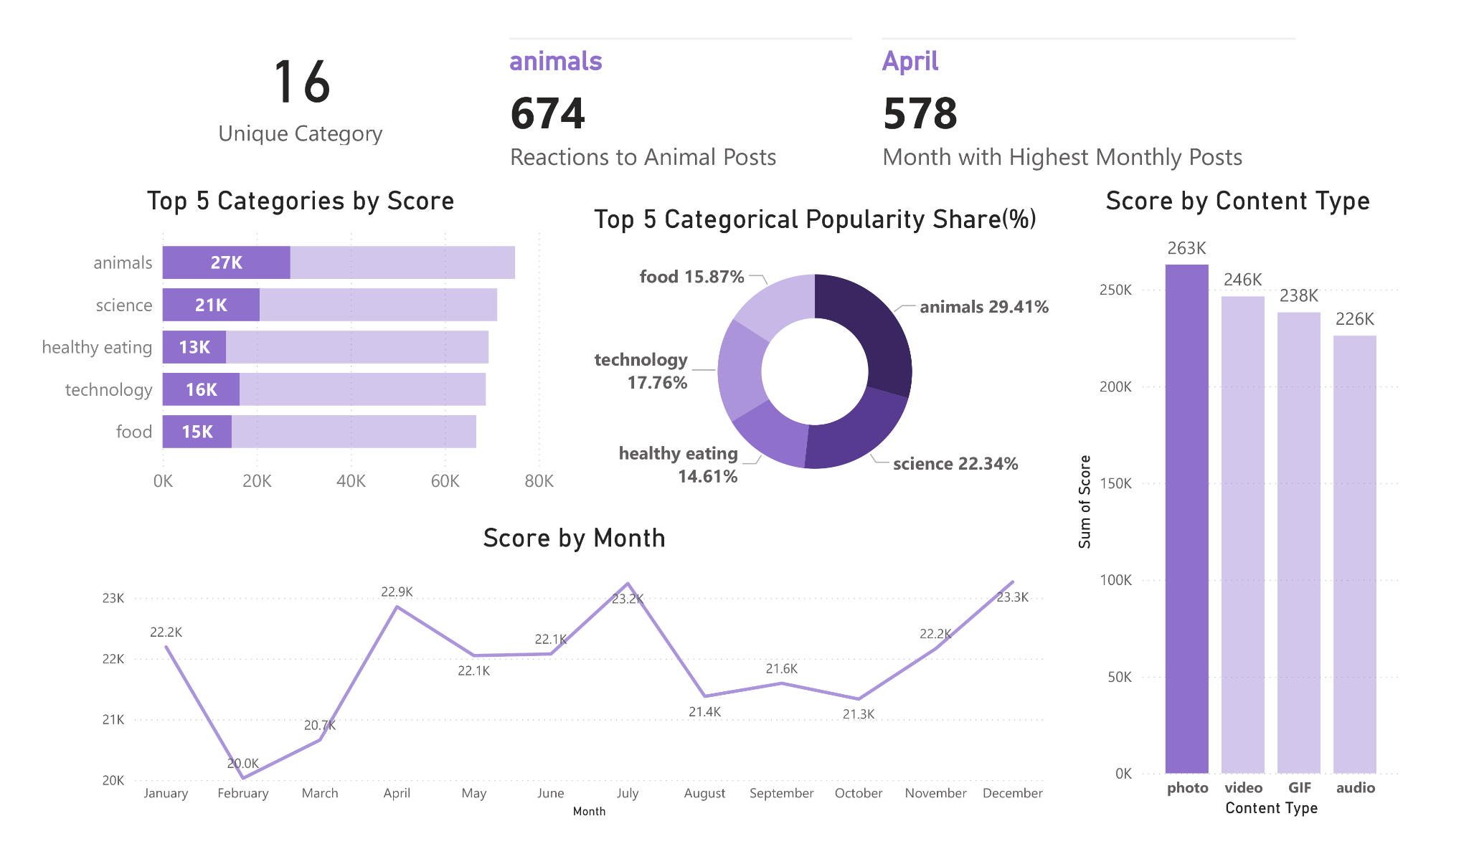

Slide 9
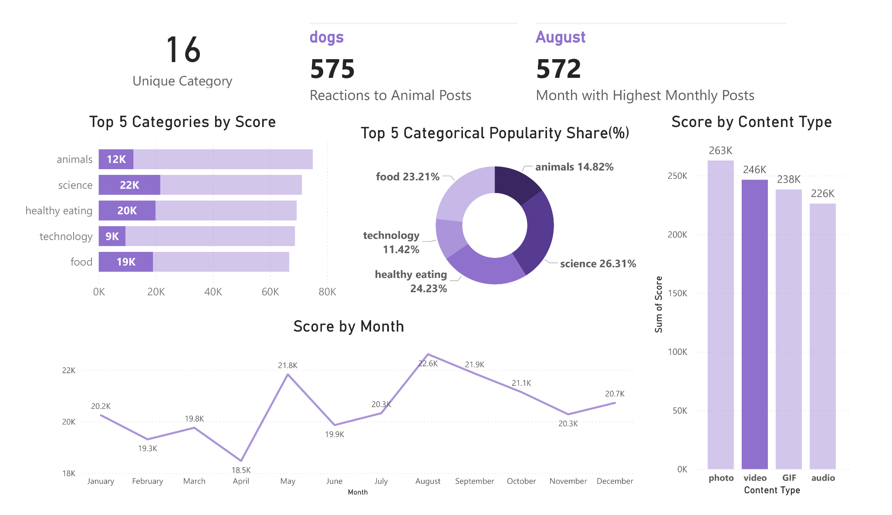

Slide 10
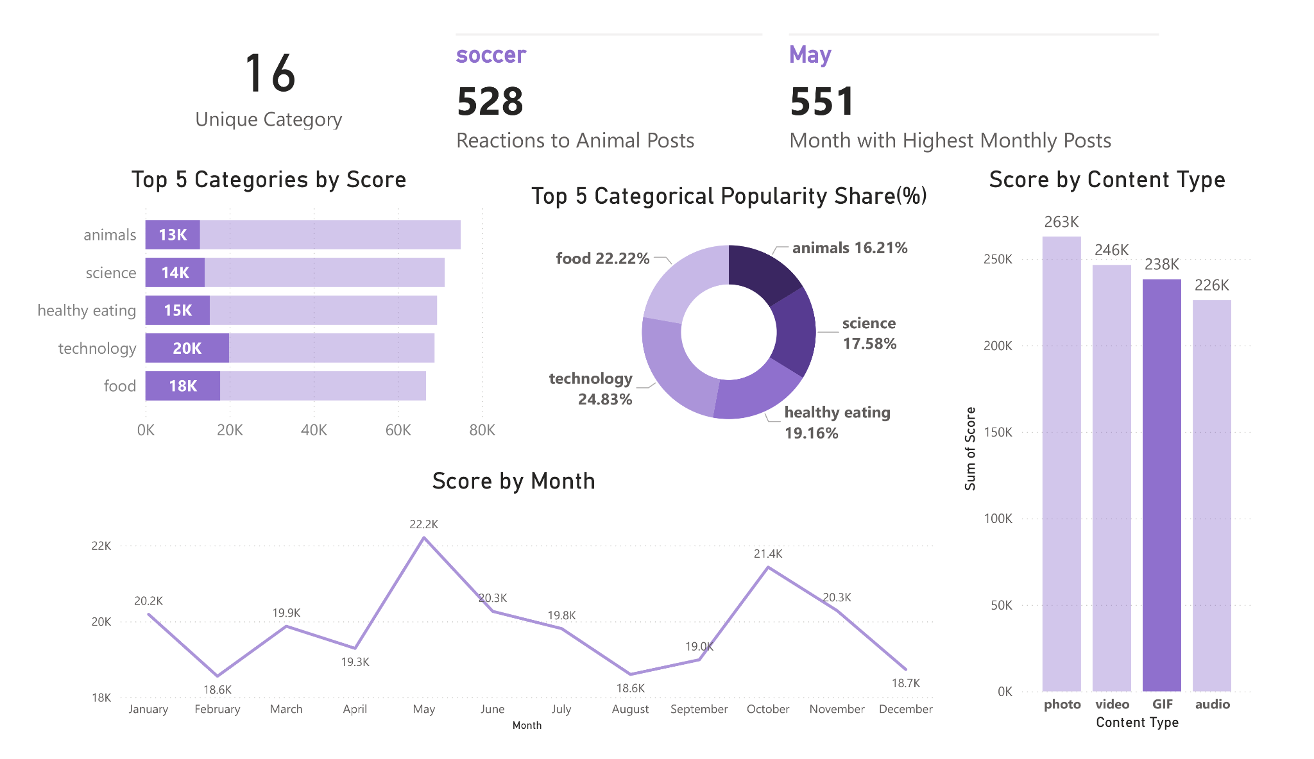

Slide 11
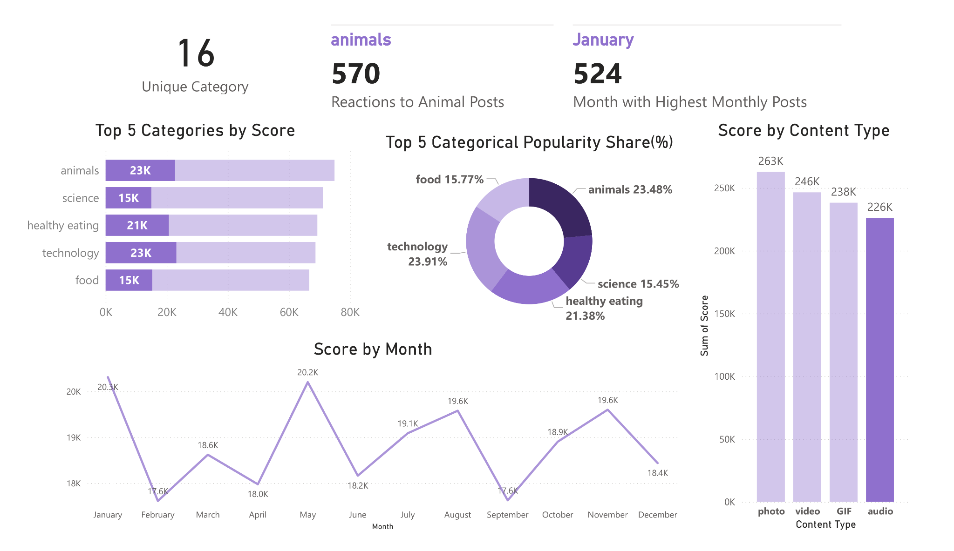

Slide 12
Insights based on Top Five Categories —>

Slide 13
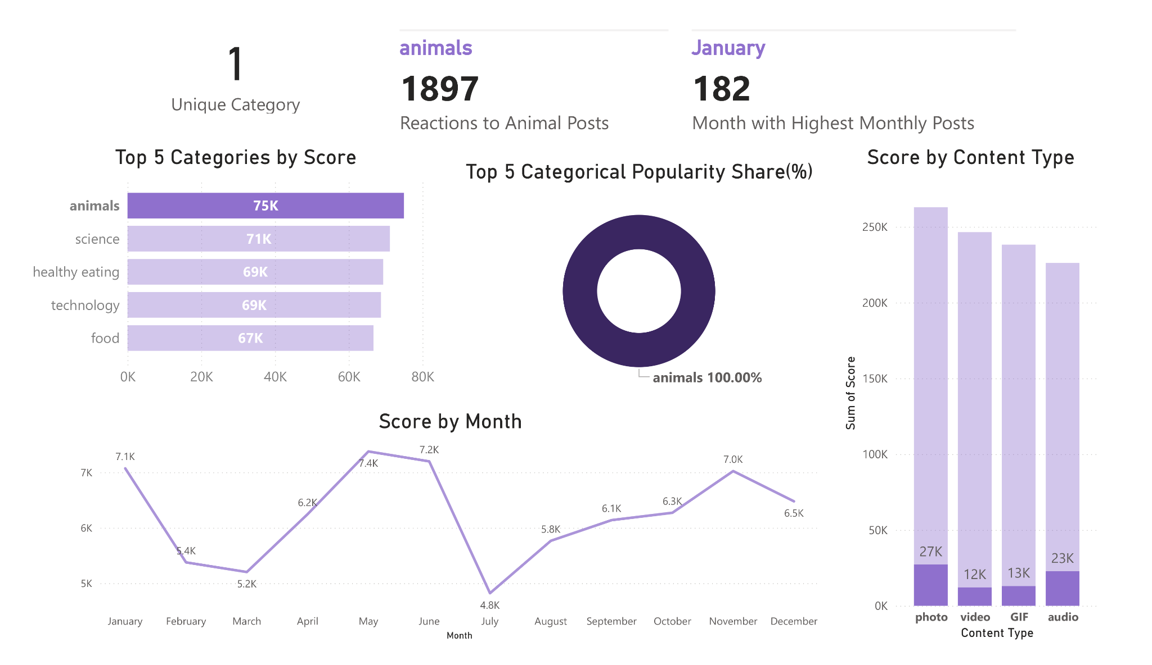

Slide 14
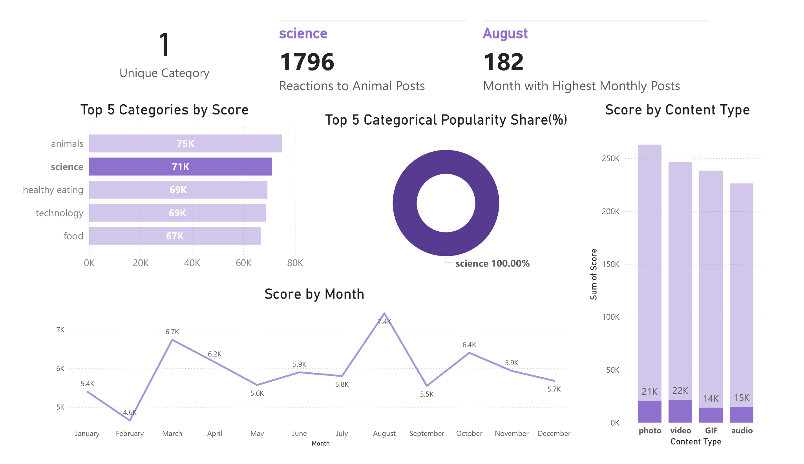

Slide 15
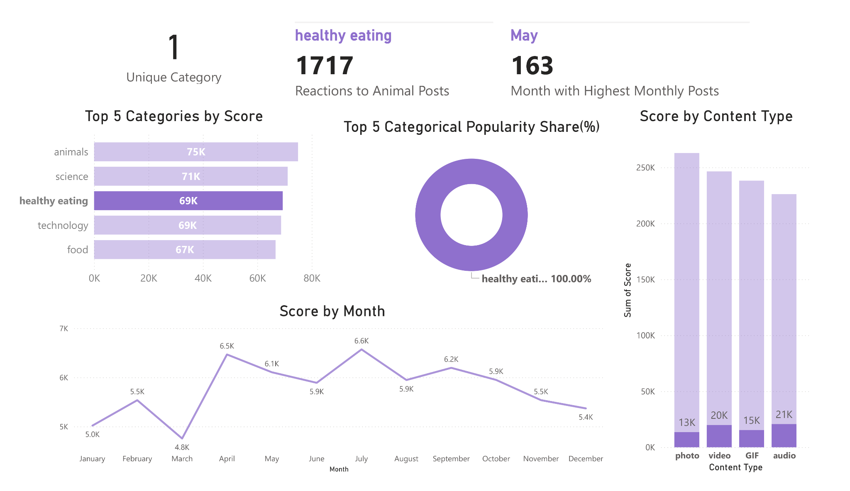

Slide 16
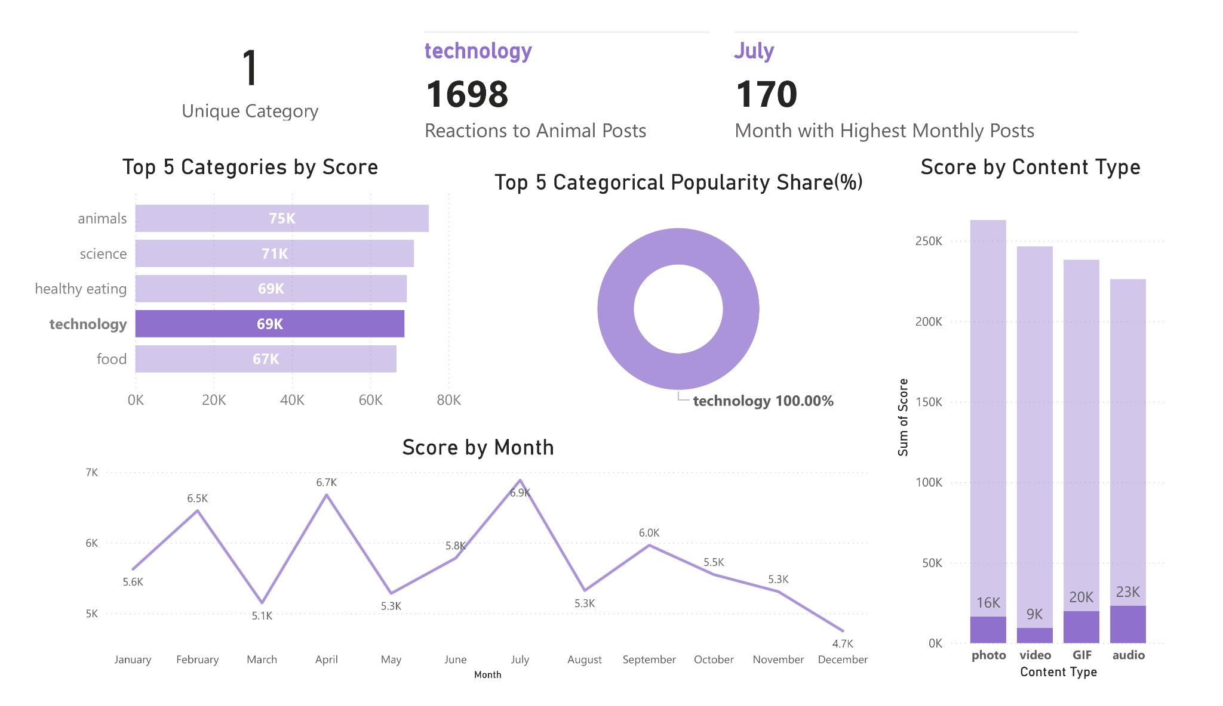

Slide 17
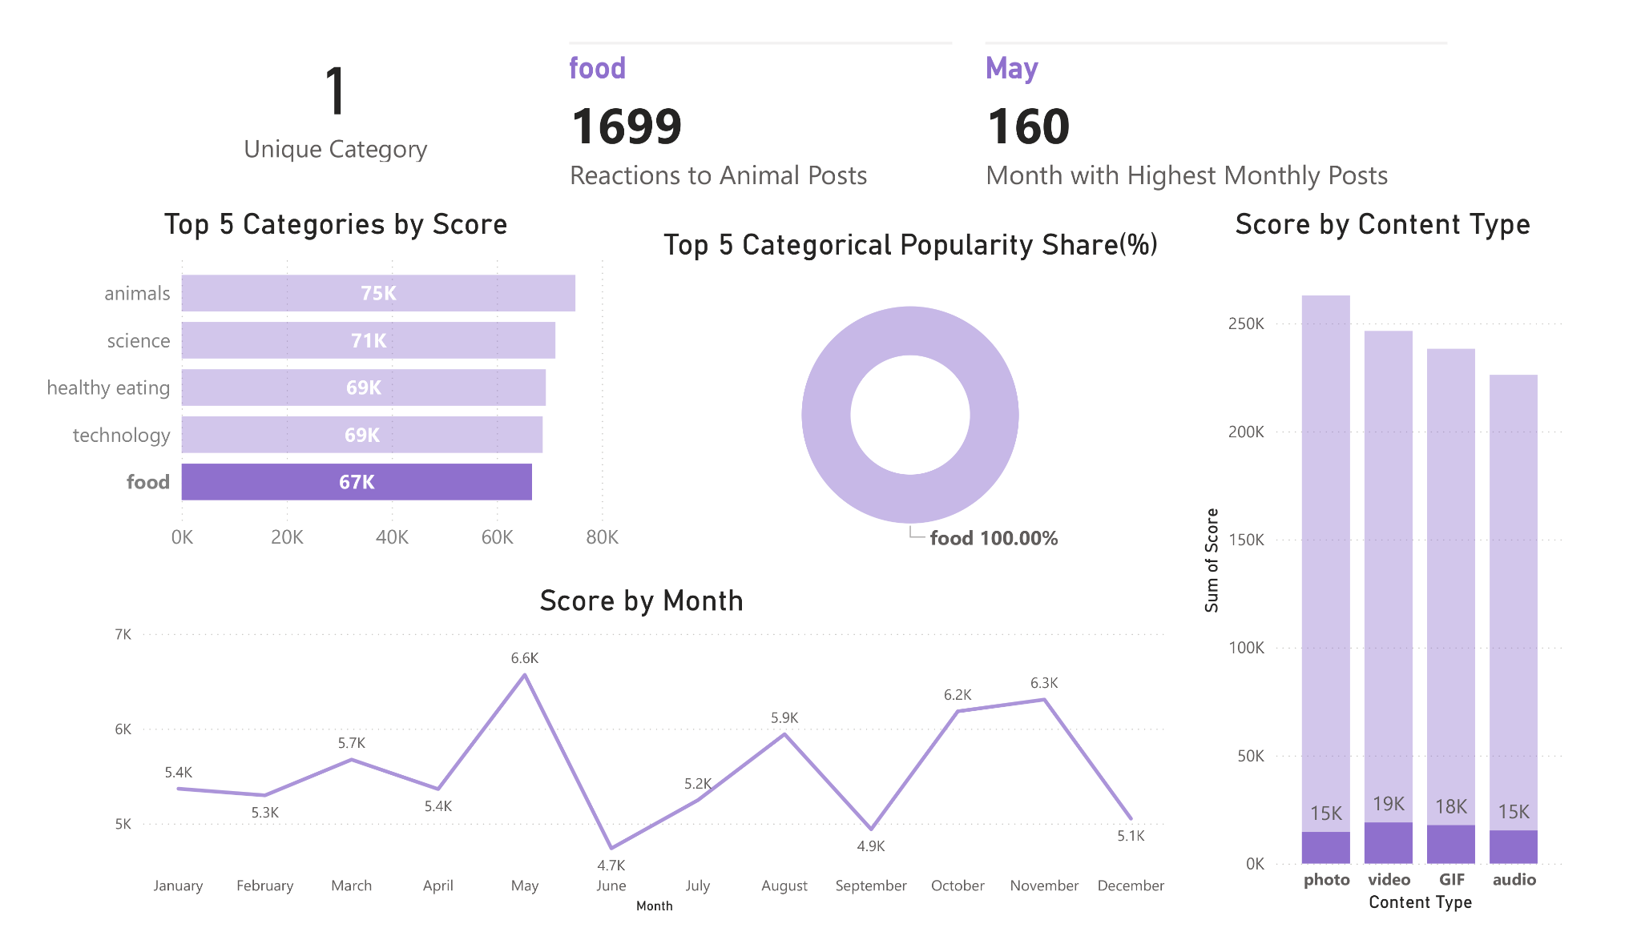

Slide 18
Overall Data Report —>

Slide 19
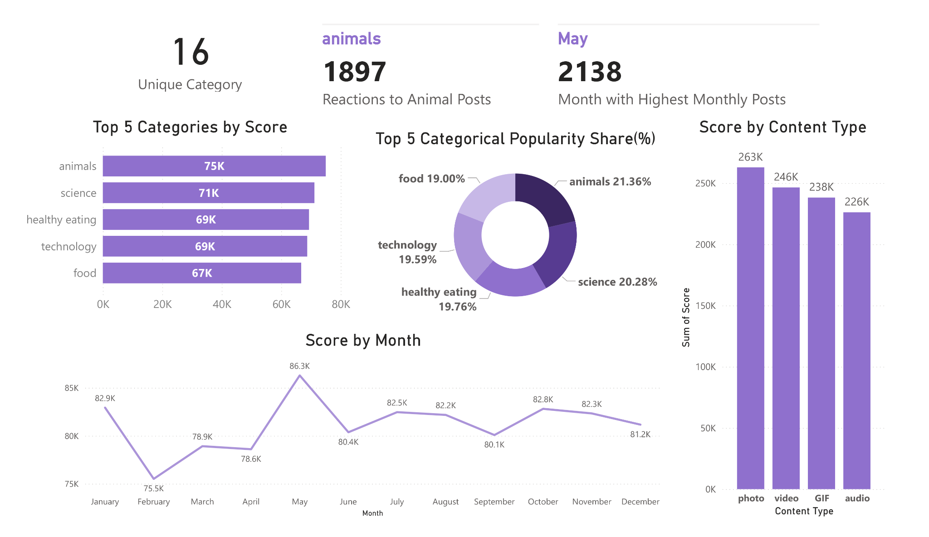

Slide 20

Social Buzz has to consider promoting more animals and science-related stuff.
The highest score 86.3K in May was declined to 81.2 by December.
Photos and Videos dominate the content formats in the space.
Summary

Slide 21

Thank you!
ANY QUESTIONS?

